Slide 1





Developing and Publishing Code for Trusted Research Environments: Best Practices and Ways of Working
Lessons from the Wales Multimorbidity Machine Learning project in Collaboration with The Alan Turing Institute
Ed Chalstrey

Slide 2
Research code best practices applicable to TREs
Developing research code as modular scripts and utilising version control software such as GitLab or GitHub.
Using unit testing, quality checks and continuous integration to ensure that research code works as expected.
Using Jupyter or R Markdown notebooks for data analysis and, where appropriate, the drafting of research papers.
Making use of DOIs (digital object identifiers), citation files and software licences when publishing research software.

Slide 3
TRE specific research code best practices
Considering the advantages and disadvantages associated with where research code destined for publication is developed, either inside or outside the TRE.
Taking care to minimise the risk of data leakage when exporting any research outputs from the TRE.
Exploring the options for researchers who lack immediate access to a TRE, or the dataset they’ll be working with e.g. synthetic data

Slide 4
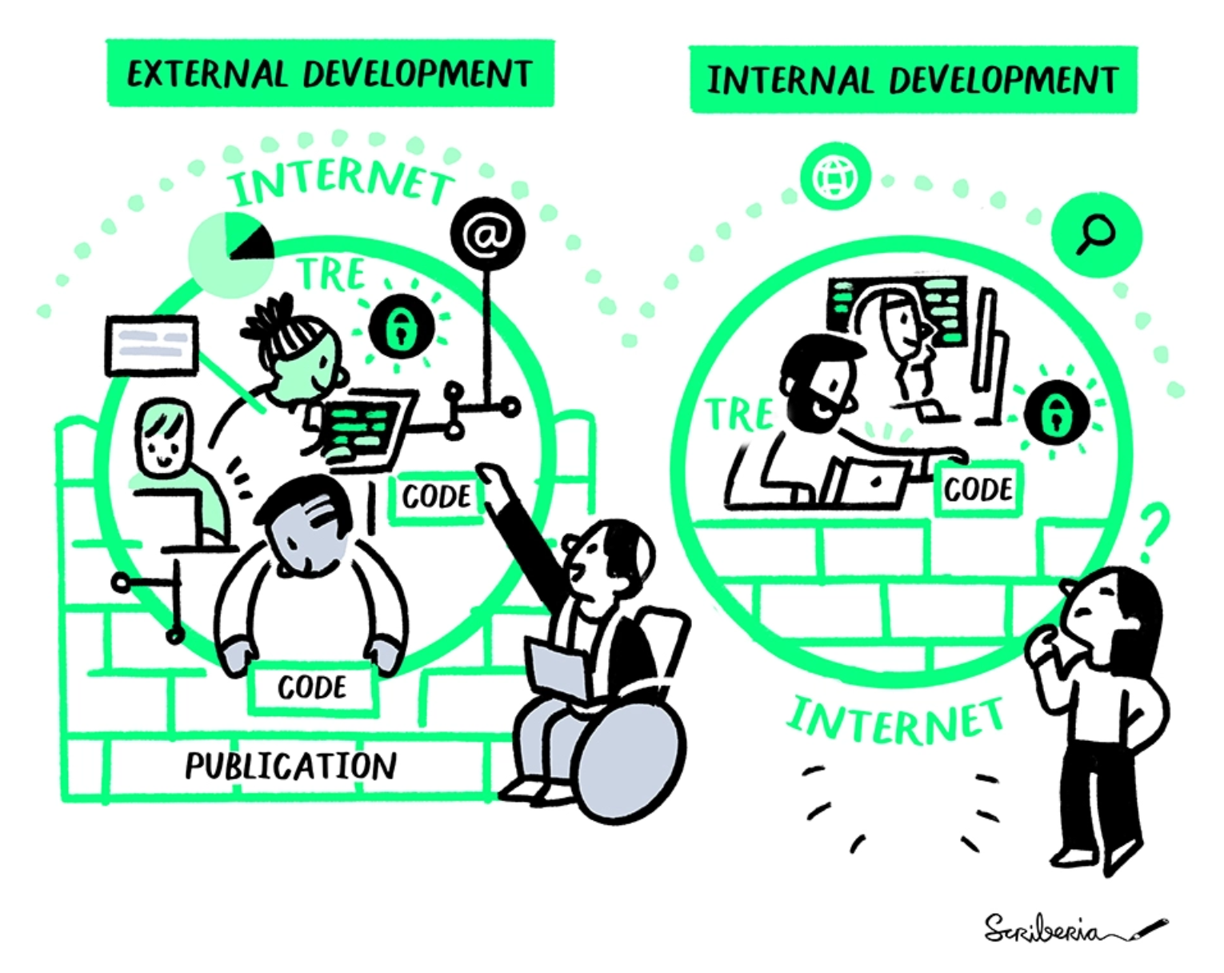
To TRE or not to TRE…
Where should researchers write their TRE code?
What should be exported from the TRE for publication purposes?

Slide 5
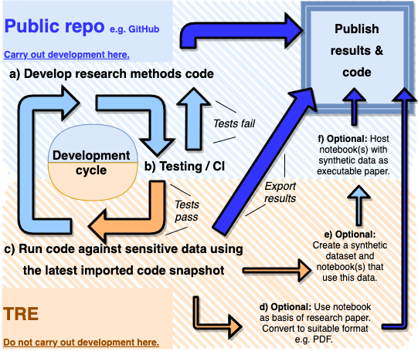
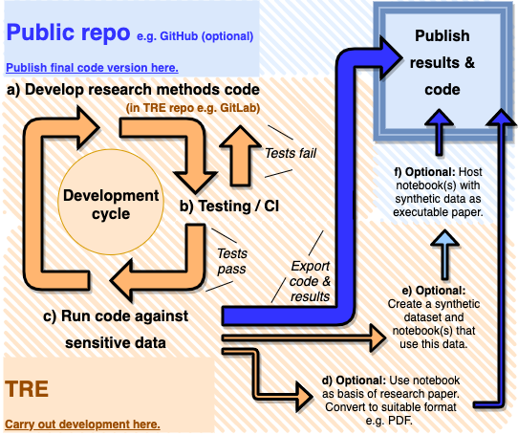
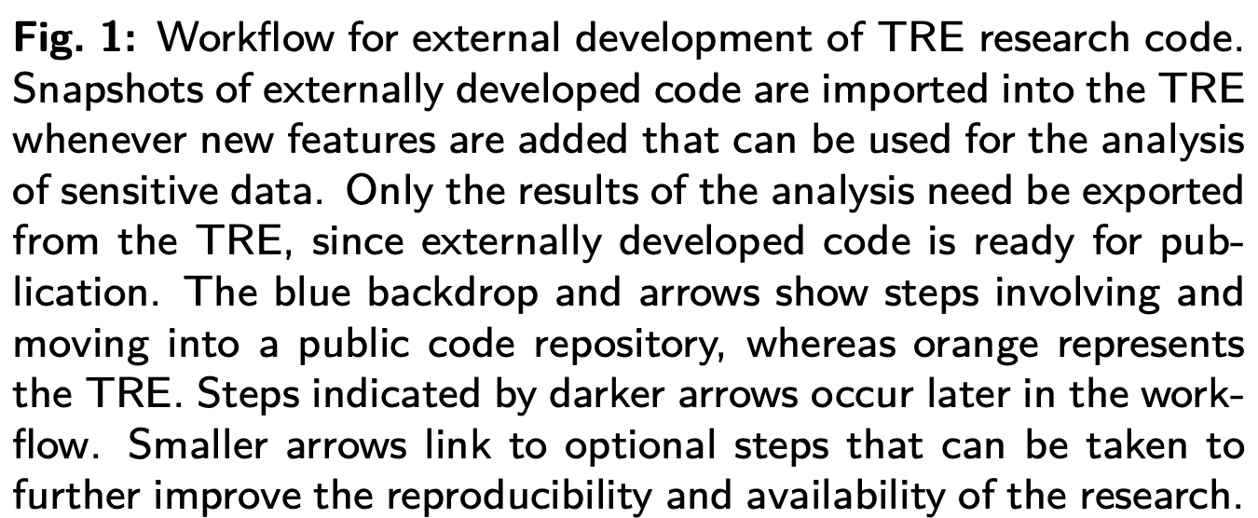
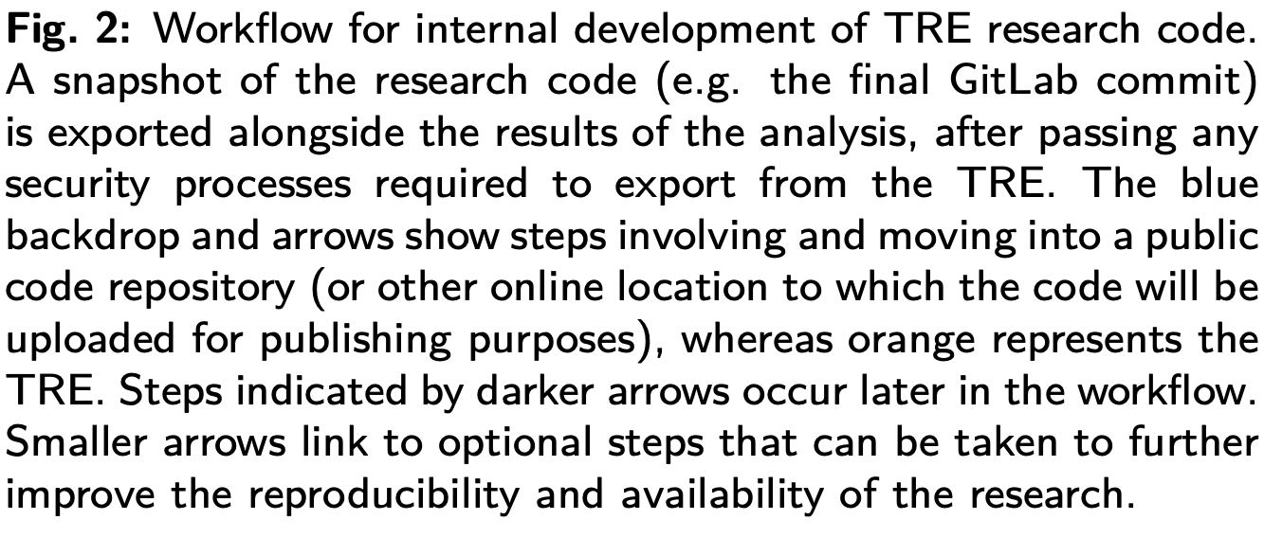
The where and the what

Slide 6
Developing and Publishing Code for Trusted Research Environments: Best Practices and Ways of Working
Blog: https://www.turing.ac.uk/blog/towards-set-best-practices-doing-research-trusted-research-environments
Full report: https://zenodo.org/record/5675093#.Yw4aPuzMJhH

Slide 7
Keeping the discussion going…
Is the external development model practical?
Could one solution be to deploy replica TREs for researchers to use as their working environment, which lack sensitive data (or contain synthetic data)?
What other obstacles have been faced when publishing TRE research?

